Slide 1
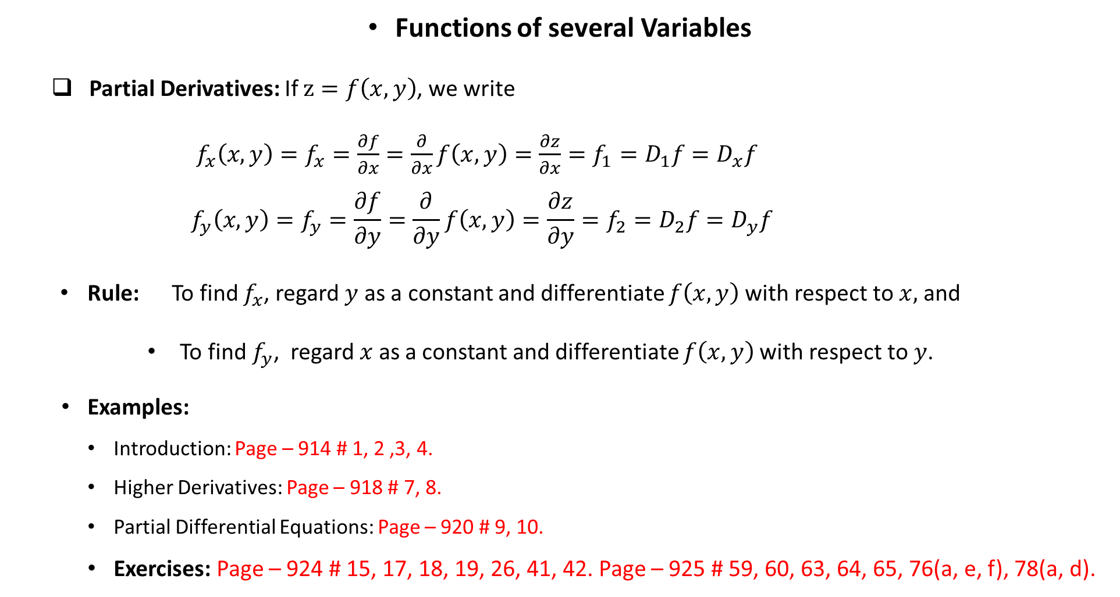
Functions of several Variables
Partial Derivatives: If $z=f\left(x,y\right)$, we write
$f_{x}\left(x,y\right)=f_{x}=\frac{∂f}{∂x}=\frac{∂}{∂x}f\left(x, y\right)=\frac{∂z}{∂x}=f_{1}=D_{1}f=D_{x}f$
$$f_{y}\left(x,y\right)=f_{y}=\frac{∂f}{∂y}=\frac{∂}{∂y}f\left(x, y\right)=\frac{∂z}{∂y}=f_{2}=D_{2}f=D_{y}f$$
Rule: To find $f_{x}$, regard $y$ as a constant and differentiate $f\left(x,y\right)$with respect to $x,$ and
To find $f_{y}$, regard $x$ as a constant and differentiate $f\left(x,y\right)$with respect to $y$.
Examples:
Introduction: Page – 914 # 1, 2 ,3, 4.
Higher Derivatives: Page – 918 # 7, 8.
Partial Differential Equations: Page – 920 # 9, 10.
Exercises: Page – 924 # 15, 17, 18, 19, 26, 41, 42. Page – 925 # 59, 60, 63, 64, 65, 76(a, e, f), 78(a, d).

Slide 2
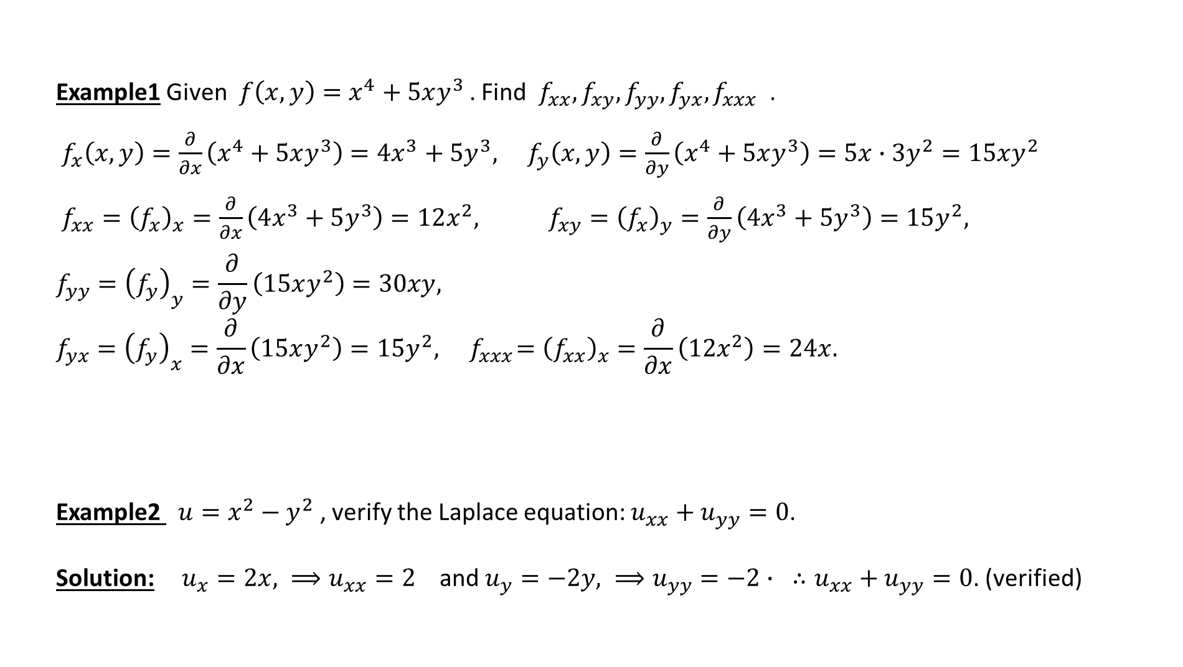
Example1 Given $f\left(x,y\right)=x^{4}+5xy^{3}$. Find $f_{xx}, f_{xy}, f_{yy}, f_{yx}, f_{xxx}$ .
$f_{x}\left(x,y\right)=\frac{∂}{∂x}\left(x^{4}+5xy^{3}\right)=4x^{3}+5y^{3}, f_{y}\left(x,y\right)=\frac{∂}{∂y}\left(x^{4}+5xy^{3}\right)=5x∙3y^{2}=15xy^{2}$
$f_{xx}={\left(f_{x}\right)}_{x}=\frac{∂}{∂x}\left(4x^{3}+5y^{3}\right)=12x^{2}, f_{xy}={\left(f_{x}\right)}_{y}=\frac{∂}{∂y}\left(4x^{3}+5y^{3}\right)=15y^{2},$
$$f_{yy}={\left(f_{y}\right)}_{y}=\frac{∂}{∂y}\left(15xy^{2}\right)=30xy, f_{yx}={\left(f_{y}\right)}_{x}=\frac{∂}{∂x}\left(15xy^{2}\right)=15y^{2},{ f}_{xxx}={\left(f_{xx}\right)}_{x}=\frac{∂}{∂x}\left(12x^{2}\right)=24x.$$
Example2 $u=x^{2}−y^{2}$ , verify the Laplace equation: $u_{xx}+u_{yy}=0$.
Solution: $u_{x}=2x, ⟹u_{xx}=2$ and $u_{y}=−2y, ⟹u_{yy}=−2∙$ $∴u_{xx}+u_{yy}=\text{0}\text{.}$ (verified)

Slide 3

Exercises: Find first partial derivatives (Page – 924).
15. $f\left(x,y\right)=x^{4}+5xy^{3}$ (part of example1)
Solution: $f_{x}=f_{x}\left(x,y\right)=4x^{3}+5y^{3}∙$
and $f_{y}=f_{y}\left(x,y\right)=0+5x∙3y^{2}=15y^{2}∙$
18. $f\left(x,t\right)=\sqrt{3x+4t}$
Solution: $f_{x}=\frac{1}{2}{\left(3x+4t\right)}^{−\frac{1}{2}}\left(3∙1+0\right)=\frac{3}{2}{\left(3x+4t\right)}^{−\frac{1}{2}}$
and $f_{t}=\frac{1}{2}{\left(3x+4t\right)}^{−\frac{1}{2}}\left(0+4\right)=2{\left(3x+4t\right)}^{−\frac{1}{2}}$

Slide 4

19. $z=\ln\left(x+t^{2}\right)$
Solution: $z_{x}=\frac{1}{x+t^{2}}∙1=\frac{1}{x+t^{2}}∙$
and $z_{t}=\frac{1}{x+t^{2}}\left(0+2t\right)=\frac{2t}{x+t^{2}}∙$
26. $u\left(r,θ\right)=\sin\left(r\cos{θ}\right)$
Solution: $u_{r}=\cos\left(r\cos{θ}\right)∙\left(\cos{θ}\right)$
and $u_{θ}=\cos\left(r\cos{θ}\right)∙\left(−r∙\sin{θ}\right)$
$=−r∙\sin{θ∙\cos\left(r\cos{θ}\right)}$

Slide 5

Exercises: Find the indicated partial derivatives (Page – 925 ).
42. $f\left(x,y\right)=y\sin^{−1}\left(xy\right)$ , $f_{y}\left(1,\frac{1}{2}\right)= ?$
Solution: $f_{y}\left(x,y\right)=\sin^{−1}\left(xy\right)+y∙\frac{1}{\sqrt{1−{\left(xy\right)}^{2}}}∙x$
$=\sin^{−1}\left(xy\right)+\frac{xy}{\sqrt{1−{\left(xy\right)}^{2}}}∙$
$f_{y}\left(1,\frac{1}{2}\right)=\sin^{−1}\left(1∙\frac{1}{2}\right)+\frac{1}{2}∙\frac{1}{\sqrt{1−{\left(1∙\frac{1}{2}\right)}^{2}}}∙1$
$=\sin^{−1}\left(\frac{1}{2}\right)+\frac{\frac{1}{2}}{\sqrt{1−{\left(\frac{1}{2}\right)}^{2}}}=\frac{π}{6}+\frac{1}{\sqrt{3}}∙$

Slide 6

59. $u=x^{4}y^{3}−y^{4}$ , verify the Clairaut’s theorem: $u_{xy}=u_{yx}$.
Solution: $u_{x}=4x^{3}y^{3}−0,$ and $u_{y}=3x^{4}y^{2}−4y^{3},$
$⟹u_{xy}=12x^{3}y^{2}∙$ $⟹u_{yx}=12x^{3}y^{2}∙$
$∴u_{xy}=u_{yx}$.
64. $f\left(x,y\right)=\sin\left(2x+5y\right)$ , $f_{yxy}=?$
Solution: $f_{y}=\cos\left(2x+5y\right)∙5$
$f_{yx}=−5\sin\left(2x+5y\right)∙2=−10\sin\left(2x+5y\right)$
$f_{yxy}=−10\cos\left(2x+5y\right)∙5=−50\cos\left(2x+5y\right)$

Slide 7

76 (d). Verify Laplace equation
$u=\sin{x}\cosh{y}+\cos{x}\sinh{y}$.
Solution: $u_{x}=\cos{x}\cosh{y}−\sin{x}\sinh{y}$
$u_{xx}=−\sin{x}\cosh{y}−\cos{x}\sinh{y}$
and, $u_{y}=\sin{x}\sinh{y}+\cos{x}\cosh{y}$
$u_{yy}=\sin{x}\cosh{y}+\cos{x}\sinh{y}$
$∴u_{xx}+u_{yy}=0\text{.}$ (verified)

Slide 8

78(c) Given $u={\left(x−at\right)}^{6}+{\left(x+at\right)}^{6}$.
Show that the function $u\left(x, t\right)$ is a solution of the wave equation $u_{tt}=a^{2}u_{xx}$ .
Solution: $u_{x}=6{\left(x−at\right)}^{5}+6{\left(x+at\right)}^{5} ,$
$u_{xx}={\left(u_{x}\right)}_{x}=30{\left(x−at\right)}^{4}+30{\left(x+at\right)}^{4}$
and,
$u_{t}=−6a{\left(x−at\right)}^{5}+6a{\left(x+at\right)}^{5},$
$u_{tt}={\left(u_{t}\right)}_{t}=30a^{2}{\left(x−at\right)}^{4}+30a^{2}{\left(x+at\right)}^{4}$
$u_{tt}=a^{2}\left[30{\left(x−at\right)}^{4}+30{\left(x+at\right)}^{4}\right]=a^{2}u_{xx}$ (shown)

Slide 9
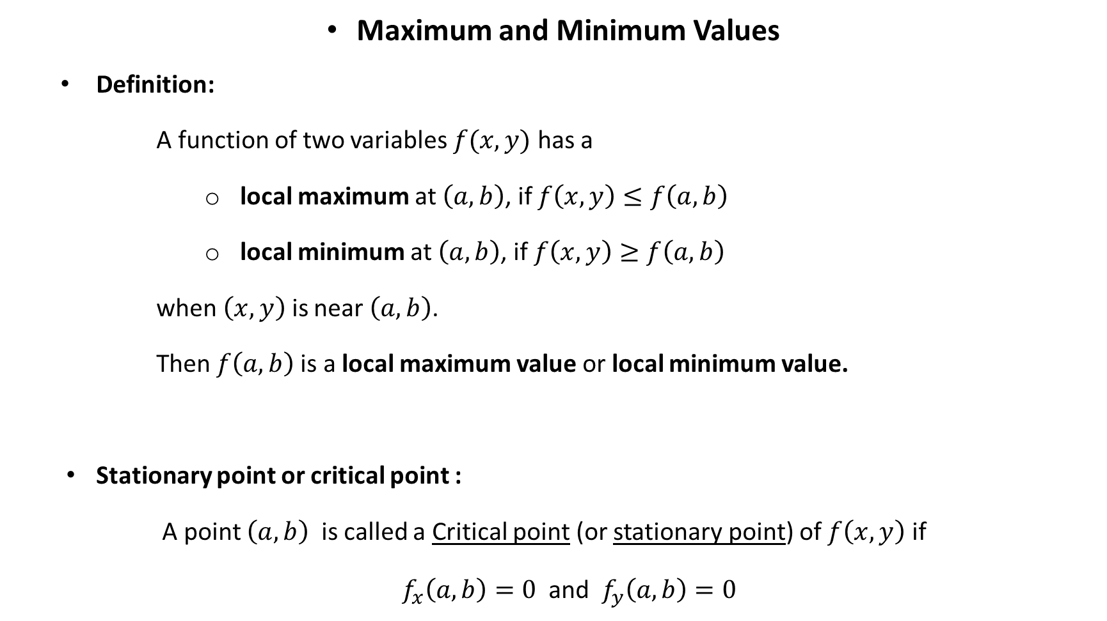
Maximum and Minimum Values
Definition:
A function of two variables $f(x, y)$ has a
local maximum at $\left(a,b\right)$, if $f\left(x,y\right)≤f\left(a,b\right)$
local minimum at $\left(a,b\right)$, if $f\left(x,y\right)≥f\left(a,b\right)$
when $\left(x,y\right)$ is near $\left(a,b\right)$.
Then$f\left(a,b\right)$ is a local maximum value or local minimum value.
Stationary point or critical point :
A point $\left(a,b\right)$ is called a Critical point (or stationary point) of $f\left(x,y\right)$ if
$f_{x}\left(a,b\right)=0$ and $f_{y}\left(a,b\right)=0$

Slide 10
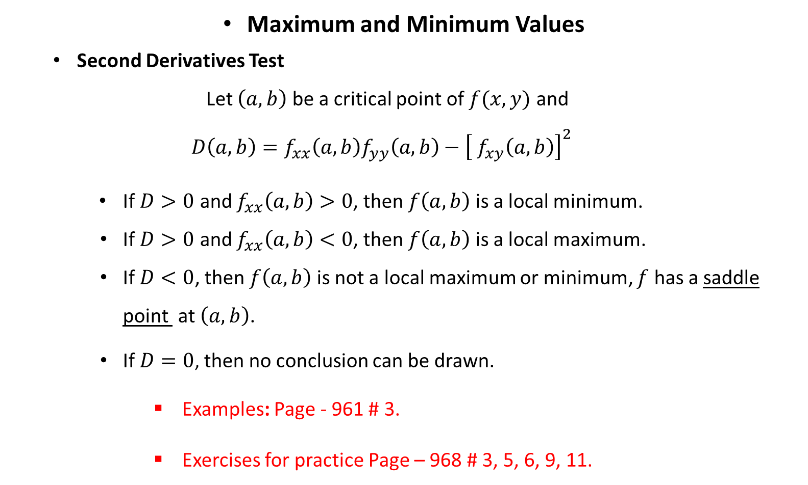
Maximum and Minimum Values
Second Derivatives Test
Let $\left(a,b\right)$ be a critical point of $f(x, y)$ and
$$D\left(a,b\right)=f_{xx}\left(a,b\right)f_{yy}\left(a,b\right)−{\left[ f_{xy}\left(a, b\right)\right]}^{2}$$
If $D>0$ and $f_{xx}\left(a,b\right)>0$, then $f\left(a,b\right)$ is a local minimum.
If $D>0$ and $f_{xx}\left(a,b\right)<0$, then $f\left(a,b\right)$ is a local maximum.
If $D<0$, then $f\left(a,b\right)$ is not a local maximum or minimum, $f$ has a saddle point at $\left(a,b\right)$.
If $D=0$, then no conclusion can be drawn.
Examples: Page - 961 # 3.
Exercises for practice Page – 968 # 3, 5, 6, 9, 11.

Slide 11
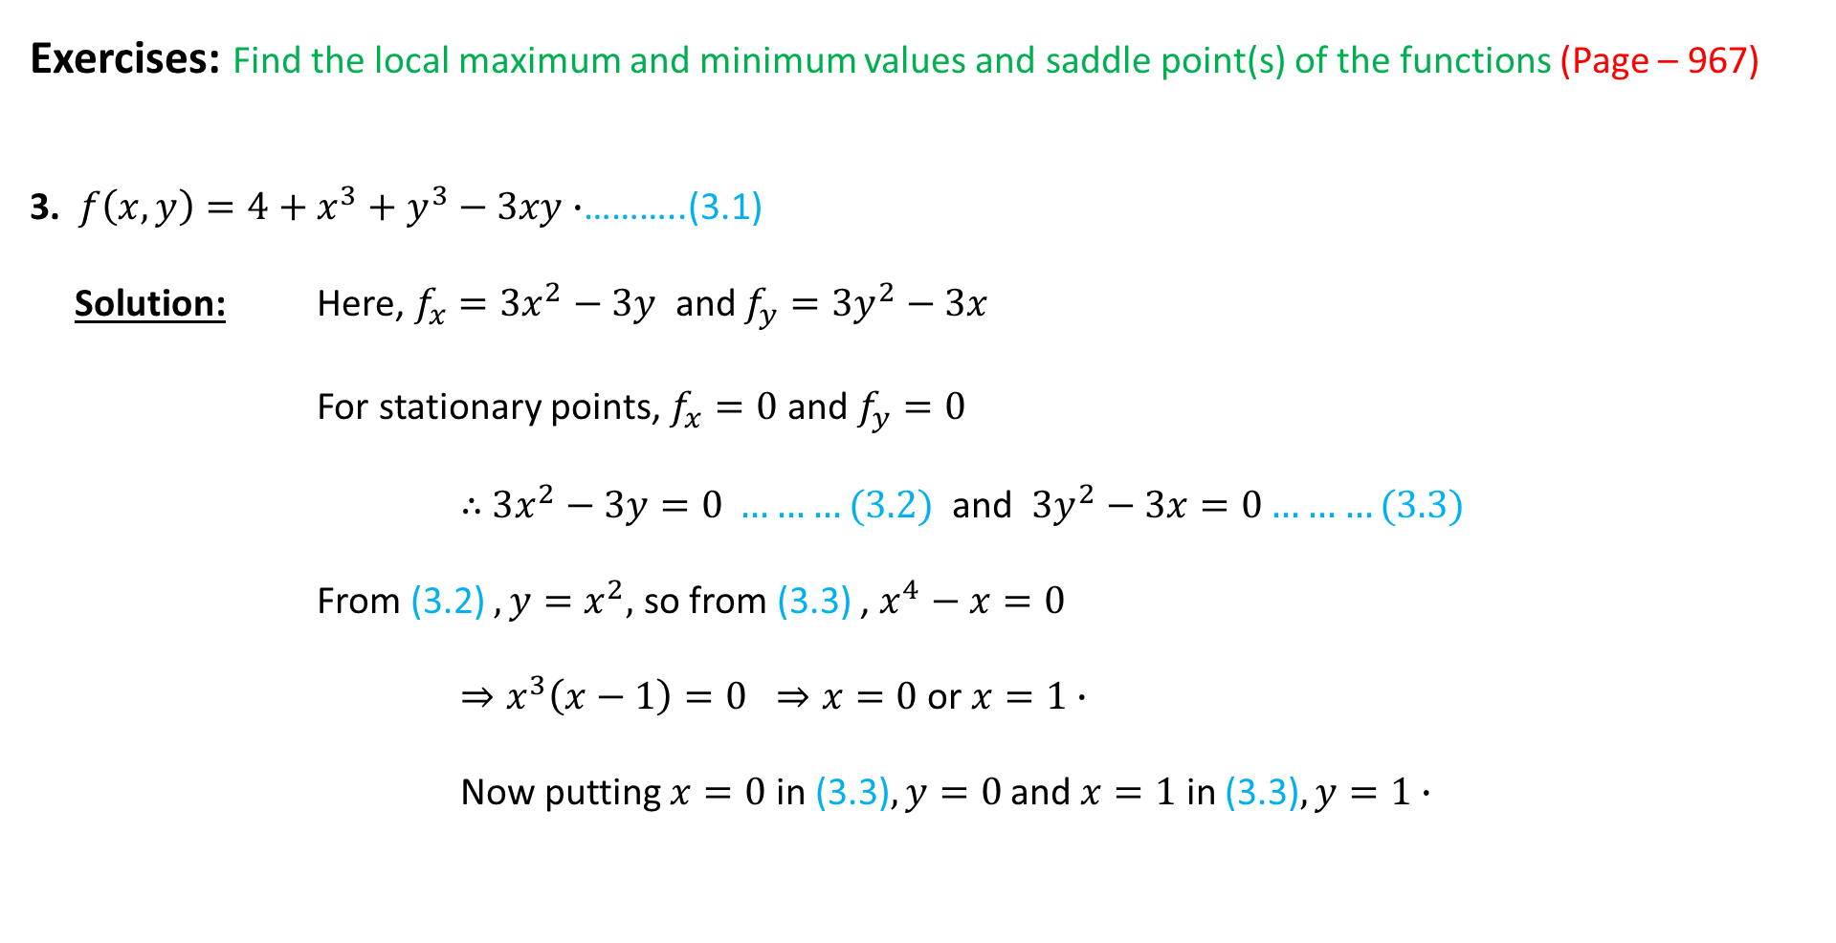
Exercises: Find the local maximum and minimum values and saddle point(s) of the functions (Page – 967)
3. $f\left(x,y\right)=4+x^{3}+y^{3}−3xy∙$………..(3.1)
Solution: Here, $f_{x}=3x^{2}−3y$ and $f_{y}=3y^{2}−3x$
For stationary points, $f_{x}=0$ and $f_{y}=0$
$∴$ $3x^{2}−3y=0 ………(3.2)$ and $3y^{2}−3x=0………(3.3)$
From (3.2) $,y=x^{2},$ so from (3.3) , $x^{4}−x=0$
$⇒x^{3}\left(x−1\right)=0 ⇒x=0$ or $x=1∙$
Now putting $x=0$ in (3.3)$,y=0$ and $x=1$ in (3.3)$,y=1∙$

Slide 12

$∴$ Stationary points are $\left(0, 0\right)$ and $\left(1, 1\right)∙$
$D\left(x,y\right)=f_{xx}\left(x,y\right)∙f_{yy}\left(x,y\right)−{\left\{f_{xy}\left(x,y\right)\right\}}^{2}$
$=6x∙6y−{\left(−3\right)}^{2}=36xy−9.$
Stationary points $(a,b)$ | $$D(a,b)$$ | $$f_{xx}\left(a,b\right)$$ | Results
$$\left(0, 0\right)$$ | $$−9$$ |  | Saddle point
$$\left(1, 1\right)$$ | $$27$$ | $$6$$ | local minimum

Slide 13

11. $f\left(x,y\right)=x^{3}−3x+3xy^{2}∙$………..(11.1)
Solution: Here, $f_{x}=3x^{2}−3+3y^{2}$ and $f_{y}=6xy$
For stationary points, $f_{x}=0$ $→ 3x^{2}−3+3y^{2}=0 →x^{2}+y^{2}=1\text{………..}(11.2)$
$f_{y}=0$ $→ 6xy=0→x=0 \text{or} y=0\text{………..}(11.3)$
Now putting $x=0$ in (11.2), $y=±1$ and $y=0$ in (11.2), $x=±1$
$∴$ Stationary points are $\left(0, 1\right)$, $\left(0, −1\right),\left(1, 0\right)$and $\left(−1, 0\right)∙$
$$f_{xx}=6x, f_{yy}=6x, f_{xy}=6y$$

Slide 14
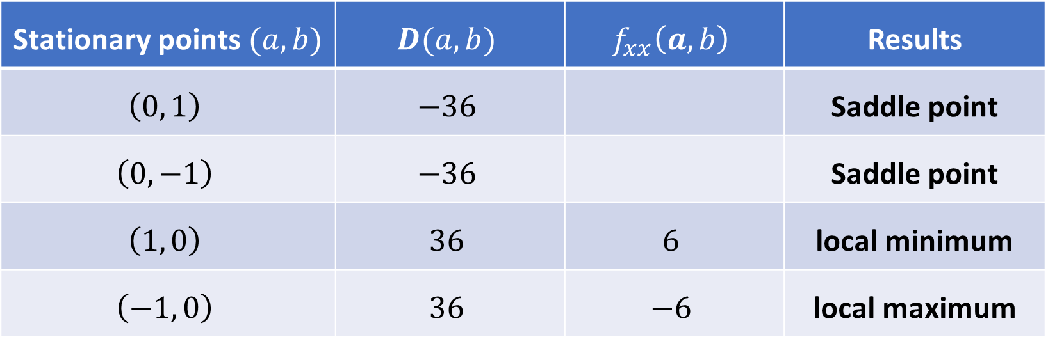
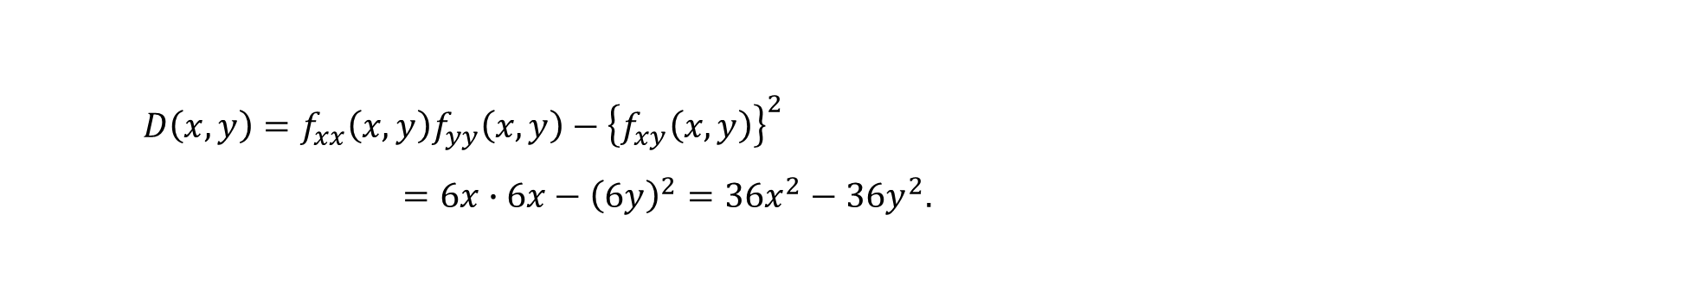
$D\left(x,y\right)=f_{xx}\left(x,y\right)f_{yy}\left(x,y\right)−{\left\{f_{xy}\left(x,y\right)\right\}}^{2}$
$=6x∙6x−{\left(6y\right)}^{2}=36x^{2}−36y^{2}.$
Stationary points $(a,b)$ | $$D(a,b)$$ | $$f_{xx}\left(a,b\right)$$ | Results
$$\left(0, 1\right)$$ | $$−36$$ |  | Saddle point
$$\left(0, −1\right)$$ | $$−36$$ |  | Saddle point
$$\left(1, 0\right)$$ | $$36$$ | $$6$$ | local minimum
$$\left(−1, 0\right)$$ | $$36$$ | $$−6$$ | local maximum

Slide 15
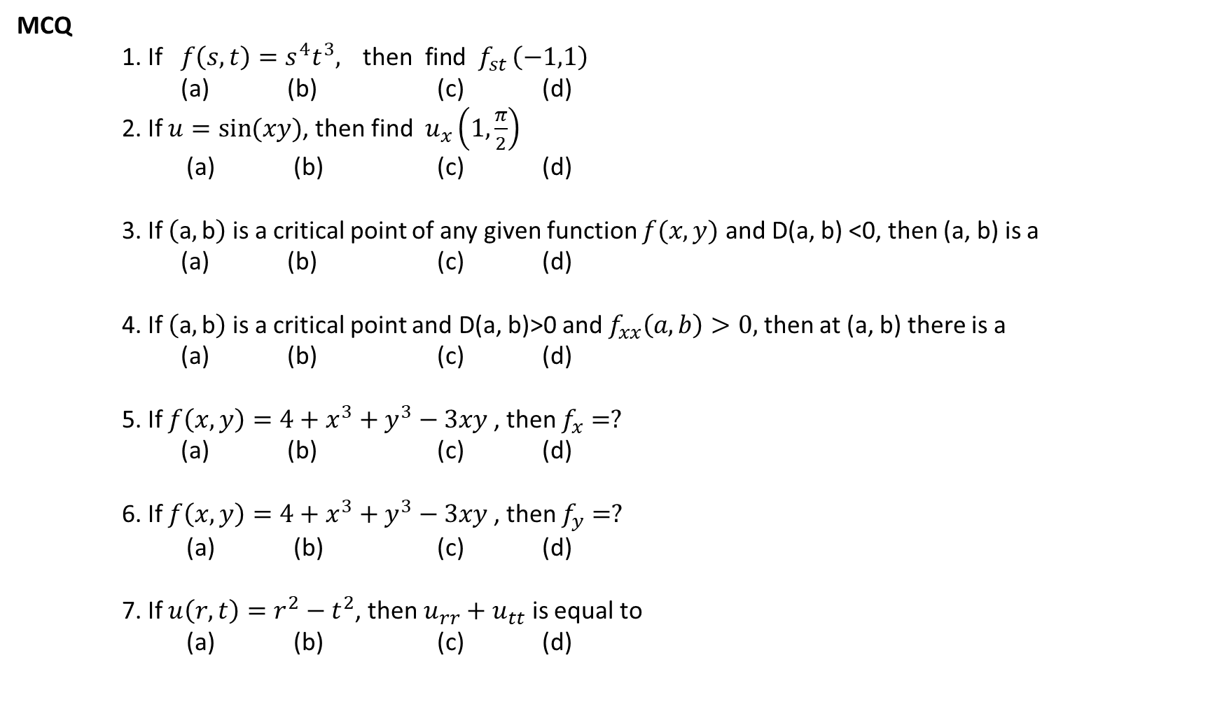
MCQ
1. If $f\left(s,t\right)=s^{4}t^{3},{ \text{then} \text{find} f_{st}}\left(−1,1\right)$
(a) (b) (c) (d)
2. If $u=\sin{(xy)}$, then find $u_{x}\left(1, \frac{π}{2}\right)$
(a) (b) (c) (d)
3. If $\left(\text{a},\text{b}\right)$ is a critical point of any given function $f(x,y)$ and D(a, b) <0, then (a, b) is a
(a) (b) (c) (d)
4. If $\left(\text{a},\text{b}\right)$ is a critical point and D(a, b)>0 and $f_{xx}\left(a, b\right)>0,$then at (a, b) there is a
(a) (b) (c) (d)
5. If $f\left(x,y\right)=4+x^{3}+y^{3}−3xy$ , then $f_{x}=?$
(a) (b) (c) (d)
6. If $f\left(x,y\right)=4+x^{3}+y^{3}−3xy$ , then $f_{y}=?$
(a) (b) (c) (d)
7. If $u\left(r,t\right)=r^{2}−t^{2}$, then $u_{rr}+u_{tt}$ is equal to
(a) (b) (c) (d)

Slide 16

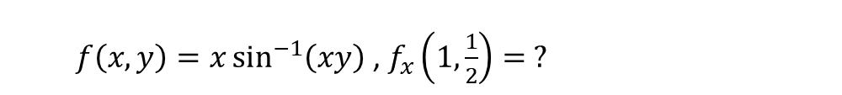
$$u\left(r,θ\right)=\cos\left(r\sin{θ}\right)$$
$$u_{r}=?$$
$$u_{θ}=?$$
$f\left(x,y\right)=x\sin^{−1}\left(xy\right)$ , $f_{x}\left(1,\frac{1}{2}\right)= ?$
$$v=\frac{1}{r^{3}}\cos{3t}$$

